Slide 1
Lecture on international relation

Slide 2
NATION
is relatively a large group of people who feel that they belong together by virtue of sharing one or more such as; traits a common language, religion/race, common history or traditional set of common customs, and a common density

Slide 3
STATE
is a legal and territory expression involving a population organized under one government with sovereign rights.
Or a state is an independent autonomous political structure over a specific territory with a comprehensive legal system and a sufficient concentration of power to maintain law and order

Slide 4
Key features of state
People
Territory
Sovereignty
refers to the exclusive jurisdiction (territorial borders) that a state possess within its territory and to its freedom to act in International affairs without being subject to the legal control of another state.
iv. Government; refer to the agency to which the will of the state is formulated, expressed and carried out

Slide 5
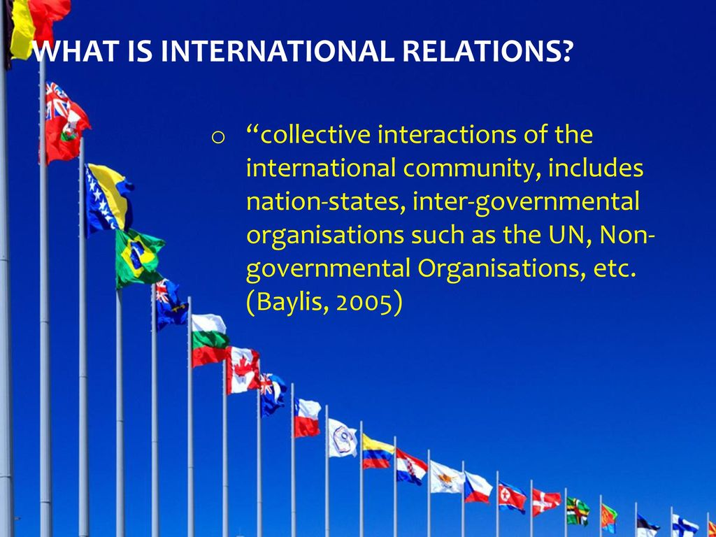

Slide 6
International relation
The academic field of international relations is a branch of political science that is concerned with the study of relations between states, the foreign policy of nation-states, and the mechanisms and institutions (such as international organizations, inter-governmental organizations, international and national non- governmental organizations and multinational corporations) through which states interact.

Slide 7
Main spheres of international relations;
International and regional peace and security, (war, peace, terrorism, organized crime)
International organizations,
Globalization,
human rights,
Social and Economic development,
International trade relations etc.
Protection of the natural environment
International economy (trade, investment, production and finance)
Defense of human rights

Slide 8
The key players in international relation
Individual heads of the government (cabinet members or other advisers who immediately assist him/her in making policy)
The whole society of which the Nation-state is a specific manifestation (various sectors of his/her own executive from political parties (including own)

Slide 9
Theories of International Relations
International relations theories can help us understand the way the international systems work, as well as how nations engage with each other and view the world. Varying from liberal, equality-centric strategies to straightforward realist concepts, international relations theories are often used by diplomats and international relations experts to dictate the direction that a government may take in regards to an international political issue or concern

Slide 10
Theories of International Relations Cont..
Realism
Idealism (Liberalism)

Slide 11
Realism in International Relations
Realism is a straightforward approach to international relations, stating that all nations are working to increase their own power, and those countries that manage to horde power most efficiently will thrive, as they can easily eclipse the achievements of less powerful nations. The theory further states that a nation’s foremost interest should be self-preservation and that continually gaining power should always be a social, economic, and political imperative.

Slide 12
Liberalism
Also called “liberal internationalism,” liberalism is based on the belief that the current global system is capable of engendering a peaceful world order. Rather than relying on direct force, such as military action, liberalism places an emphasis on international cooperation as a means of furthering each nation’s respective interests. Liberalists believe that the negative consequences of force—such as economic losses and civilian casualties—far exceed its potential benefits.

Slide 13
Therefore, liberal politicians generally prefer the use of economic and social power in achieving their national goals (for instance, obtaining the agreement of a neighboring country to help secure a border).
In today’s globalized society, using economic tactics—such as bilateral trade agreements and international diplomacy—can be more effective in advancing political interests than threatening force.

Slide 14
` It can be argued that the liberalist tradition, perpetuated by the United States, has become the dominant system in international relations, with established values and international institutions in place to regulate this order

Slide 15
Regional integration
Defined as a grouping of three or more states whose goal is the formation of a distinct political entity
A regional arrangements voluntary association of sovereign states that have developed fairly elaborate organization tools among them some bond of unity.

Slide 16
Regional integration can be defined along three dimensions:
Geographic scope integration illustrating the number of countries involved in an arrangement eg; SADC, EAC,AU etc.
Substantive coverage or width that is the sector or activity coverage integration (trade, labor mobility, macro-policies, sector policies, etc.), and
Depth of integration measure the degree of sovereignty a country is ready to surrender, that is from simple coordination or cooperation to deep integration.

Slide 17
Foreign policy
FP; Consist of decision and action which involves to some appreciable extent relation between State and others. (Prof. Joseph Framkel)
According to Rodee; FP involves the implementation of group principles which shapes the behavior pattern of a State which negotiating with others States to protect or further its interest.
is a nation’s protocol for making and maintaining relations with foreign countries. Refers to the nation’s international goals and its strategies to achieve those goals.

Slide 18
GOALS Foreign Policy
1. National Security 2. Establishing free and open trade 3. Establishing world peace 4. Supporting democracy around the world 5. Providing aid to people in need

Slide 19
How IR and FP connected
Protects unity and integrity of the country
Defends the interest of the citizen
Maintaining contacts and develop good relationship with other state
Keeping the state safe and secure

Slide 20
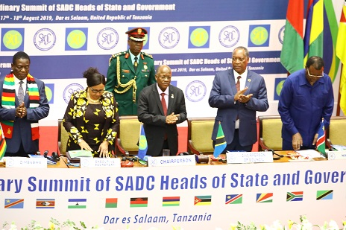
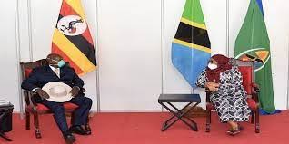
DIPLOMACY
IS the process of conducting, communication among states through official recognized representative diplomacy main two works negotiation and bargaining
Negotiation the diplomat should be an excellent negotiator a catalyst for peace and understanding between people.

Slide 21
What is the value of diplomacy?
Diplomacy strengthens the relationships between our country and foreign countries. The art of diplomacy seeks to develop good will and prevent conflict and wars. It allows for nonviolent answers to the problems facing each nation. Diplomacy is highly valuable in today’s world.
The functions of diplomacy are communication, negotiation, intelligence gathering, image management, and policy implementation.

Slide 22
What is the importance of diplomacy in International Relations?
Diplomacy is most importantly used to complete a specific agenda. Therefore without diplomacy, much of the world’s affairs would be abolished, international organizations would not exist, and above all the world would be at a constant state of war. It is for diplomacy that certain countries can exist in harmony.

Slide 23
importance of diplomacy in international relations? CONT…
Diplomacy is the art and science of maintaining peaceful relationships between nations, groups, or individuals. … Diplomats try to help their own country, encourage cooperation between nations, and maintain peace. A group of diplomats representing one country that lives in another country is called a diplomatic mission.

